Slide 1






Slide 2

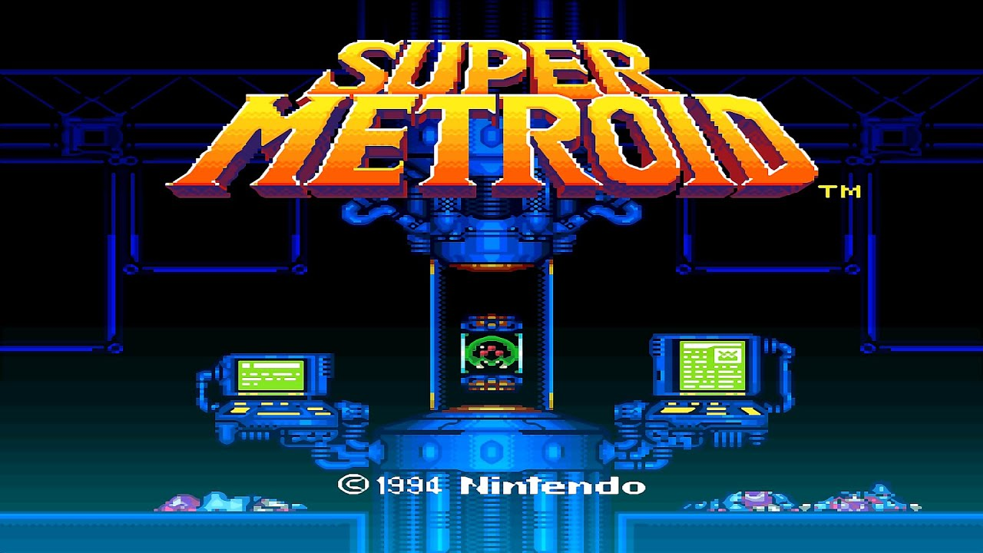
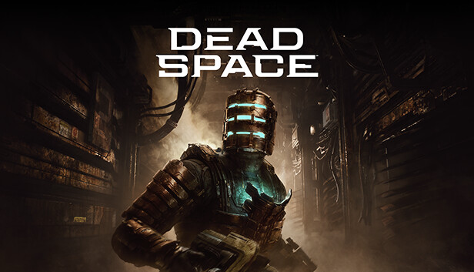
A Horror/Metroidvania hybrid
2D Platformer with the iconic gameplay of Super Metroid with the terror of Dead Space
fusing horror chase sequences and events that make the player vulnerable with classic metroidvania level exploration and mechanics.

Slide 3








Art Style
Futuristic dystopian world full of broken machinery, pipes and, scrap metal.
Dark broken down factory with different sections still operating.

Slide 4
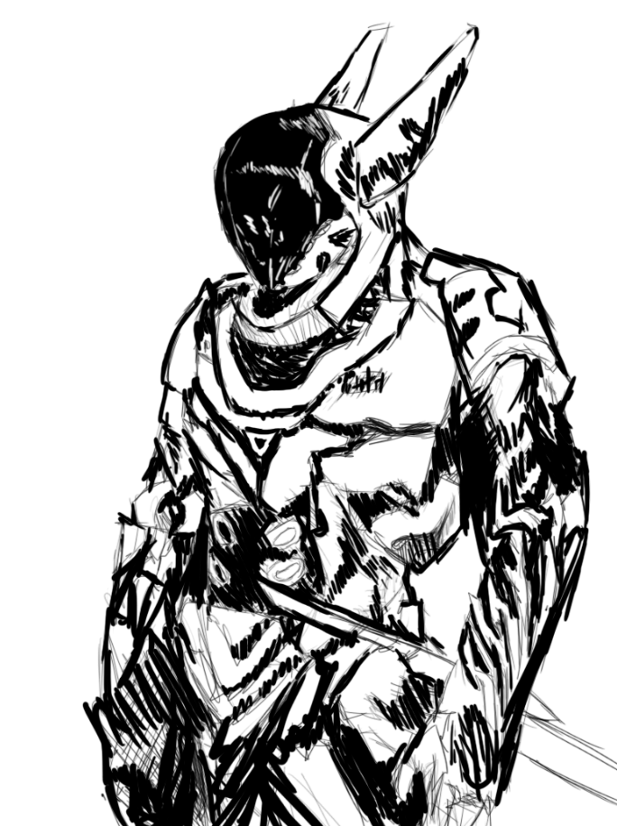


A broken world, live with robots
The year is 3030; Humanity is gone and in its place is a society of robots. An unknown virus has spread down in the factory where the robots are made and have turned hostile. Take control of Beta-14; who has awakened in the junkyard full of scrapped robots. Journey into the factory and survive against dangerous threats to find the origins of the virus.

Slide 5
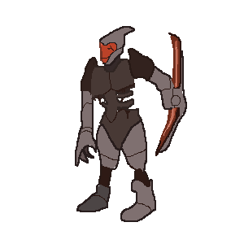

The dangers you will face
Navigate various hazards in the abandoned factory like machine crushers and lava
Fight and survive against the rampant robots
Hunter: Tough robotic beings armed with piercing blades that will hunt you down in each level
Walker: Slow and clunky; they make up for it with strength and ranged attacks.

Slide 6
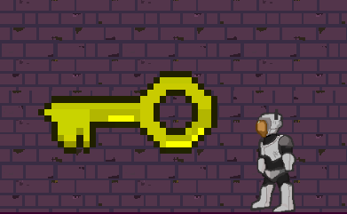

Progression
In each level of the game their will be colored keys to gather to open different doors.
These doors will open paths to abilities, navigate the level quicker, or to progress to the next level
Special keycard must be collected to unlock a special elevator to move on to the next level
New abilities to get In each level that will help with killing enemies or traversing the level with new mobility.

Slide 7



Gameplay
Gain special abilities overtime that will you allow you to traverse and engage enemies in unique ways
Plasma Blade: Close ranged attack if you wish to get close to your enemies
Robotic Dash: Traverse gaps or close the distance between your foes; will have a cooldown
Energy Blaster: Shoots balls of energy that allows you take out foes from afar
Grapple Hook: Allows you reach new heights and explore new areas

Slide 8


Gameplay Showcase

Slide 9



What is it on?
PC on Steam
Xbox and Playstation

Slide 10
Recap
Visual comparison on what to expect
Glimpse of the story
Hazards and Enemies
Progression
Combat
Gameplay
Game release

